Slide 1



Unity3D & Vuforia
Workshop By: Joel Perez

Slide 2
What is Unity3D
Unity3D is the worlds most popular Real-Time Creation Platform
Unity is used to create half of the world’s games. They’re real time platform, powered by tools and services, offers incredible possibilities for game developers, and creators across industries and applications.
My Description of Unity3d:
An Integrated Development Environment (IDE) like software for game developers and media developers.
Workshop By: Joel Perez

Slide 3




Who uses Unity3D
Workshop By: Joel Perez

Slide 4
What is Vuforia
Vuforia is an augmented reality software development kit (SDK) for mobile devices that enables the creation of augmented reality applications
My Description of Vuforia:
An Augmented Reality Library used to create amazing cutting edge AR apps for mobile phones.
Workshop By: Joel Perez

Slide 5
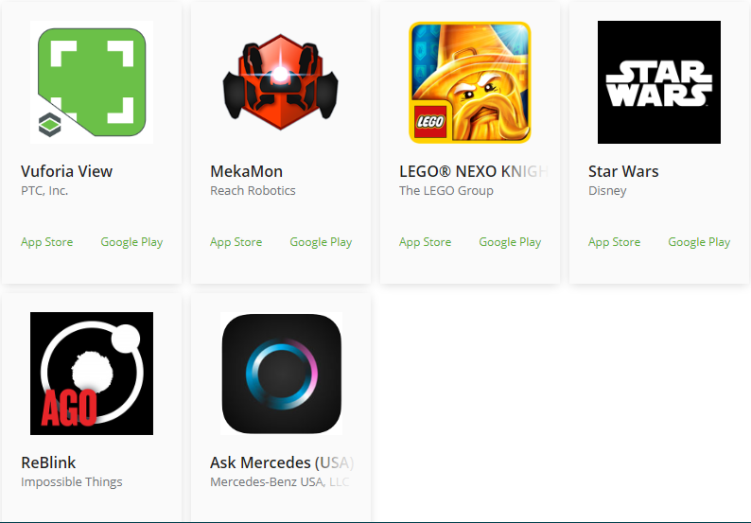
Vuforia Apps
PTC Vuforia and its many awesome apps
Workshop By: Joel Perez

Slide 6
AR vs VR
The simplest way to think about the difference between AR and VR is this:
Virtual Reality creates a “fake” world around you while Augmented Reality adds objects/things to the “real” world.
Workshop By: Joel Perez

Slide 7
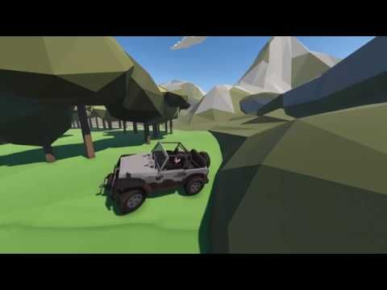

AR & VR Examples
Workshop By: Joel Perez

Slide 8
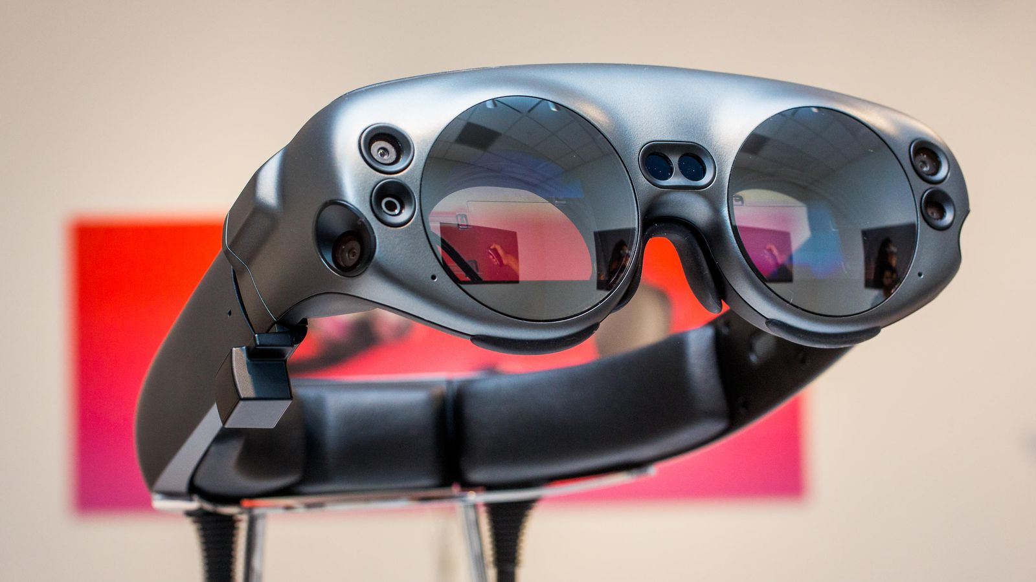

AR Headset
Workshop By: Joel Perez

Slide 9
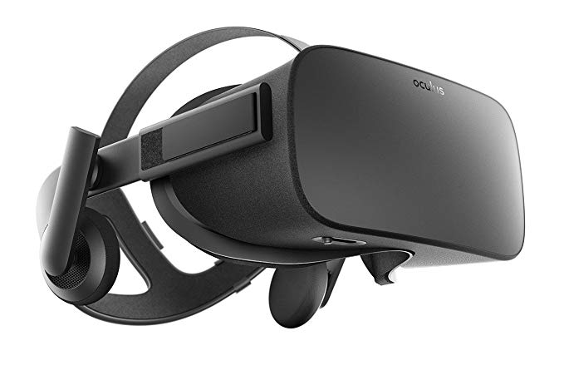

VR Headset
Workshop By: Joel Perez

Slide 10
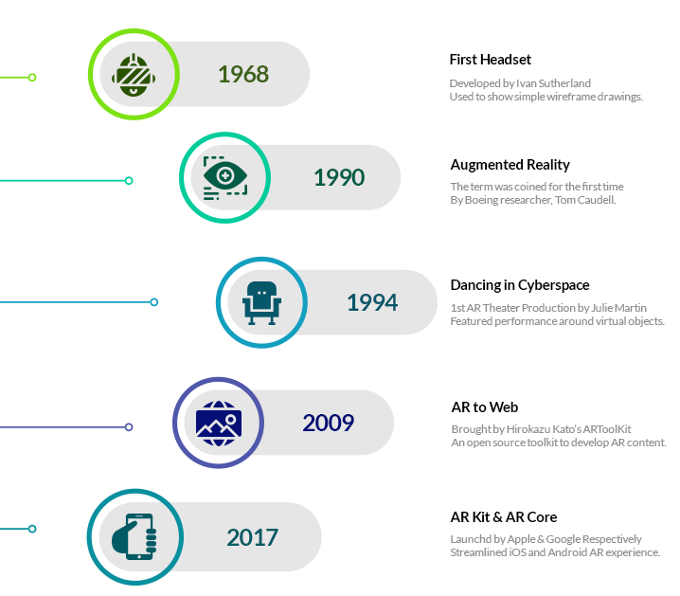
www.newgenapps.com
Workshop By: Joel Perez

Slide 11

www.newgenapps.com
Workshop By: Joel Perez

Slide 12
What kind of hardware?
Central Processing Unit (CPU aka brains carries out all the instructions)
Display / Monitor ( So we can see what's going on)
Camera (Our electronic eyes)
Tracking (Used to track patterns and images)
Solid State Compass (Magnetometer used in things like mobile phones which outputs either digital or analog data to a microprocessor proportional to its orientation)
Accelerometer ( Measures the change or rate of velocity in a device or vehicle)
Input devices (Joysticks, pointers, etc.)
GPS (For geolocation to anchor to Realtime location
Software and algorithms (That's why we are here for)
Workshop By: Joel Perez

Slide 13
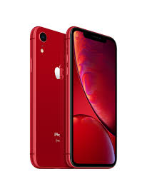
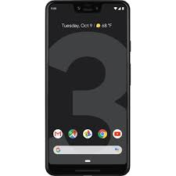
Hardware Continued..
Our mobile phones and tablets contain the both the hardware and software required for AR. This makes them not only suitable for AR but it makes it so much easier for everyone to experience. VR can also use our mobile phones, however they still require additional equipment to work.
iPhone XR
Google Pixel 3
Workshop By: Joel Perez

Slide 14

The 2 AR Types We Know
Tag (Marker(
Tag-less (Marker-less)
A tag based AR app reacts to a predefined marker
A tag-less AR app reacts to solid surfaces that it detects
Workshop By: Joel Perez

Slide 15

Marked Image
Workshop By: Joel Perez

Slide 16
Let’s Begin Creating Our App
Start new Unity 3D up
Get Unity License (On your laptops)
Start new 3D project in Unity
Name it Unity_Vuforia_First_Last
Workshop By: Joel Perez

Slide 17
Development underway…
Import Vuforia AR Camera
Create Vuforia Developer Account
Get Vuforia License
Create Vuforia Database
Upload our image we want marked
Download Database
Workshop By: Joel Perez

Slide 18
Development underway…
Unity uses Meters we need to convert pixels to meters (www.UnitConverter.net)
Insert our marked image and the replacement video
GameObject / Image
GameObject / 3D Object / Quad
Workshop By: Joel Perez

Slide 19
Development underway…
Adjust our Image and Quad
Attach our Video to the Quad Object
Add component / video / link video
Test our work
Workshop By: Joel Perez

Slide 20
Build Time!
File / Build Settings
Player Settings
Choose our platform
Give it an icon, an app name, and begin the building process.
Test our app on a device
Workshop By: Joel Perez

Slide 21
Important Resources
Roketteere (Joel Perez) GitHub – Project Files
https://github.com/roketteere/AR_MarkerApp_InTech_JoelPerez
Unity Vuforia Manual:
https://docs.unity3d.com/Manual/vuforia-sdk-overview.html
Vuforia Developer:
https://developer.vuforia.com/
Pixabay – Free to use media:
www.PixaBay.com
Unit Conversion Site:
https://www.unitconverters.net/
GitHub (Save Opensource Projects)
www.GitHub.com
Workshop By: Joel Perez

